Slide 1
Application Layer Protocols: FTP, HTTP, WWW and SMTP
CS4283/5283: Computer Networks
Uttam Ghosh
uttam.ghosh@vanderbilt.edu
Computer Science
Vanderbilt University

Slide 2
File Transfer Protocol (FTP)

Slide 3
File Transfer Protocol
FTP (File Transfer Protocol) is the simplest and most secure way to exchange files over the Internet.
Transferring files from a client computer to a server computer is called "uploading" and transferring from a server to a client is "downloading".
To access an FTP server, users must be able to connect to the Internet or an intranet (via a modem or local area network) with an FTP client program.

Slide 4
File Transfer Protocol
FTP doesn’t not really move, it copies files from one computer to another
FTP is the file transfer protocol in the Internet's TCP/IP protocol suite’s Application Layer.
FTP uses the services of TCP. It needs two TCP connections.
The well-known port 21 is used for the control connection and the well-known port 20 for the data connection.

Slide 5
The FTP model
FTP protocol falls within a client-server model, i.e. one machine sends orders (the client) and the other awaits requests to carry out actions (the server).
During an FTP connection, two transmission channels are open:
A channel for commands (control channel) , a control channel that stays open for the entire session
A channel for data , data channel that opens and closes to transfer data such as folder listings and files to or from the server as requested by the client.

Slide 6
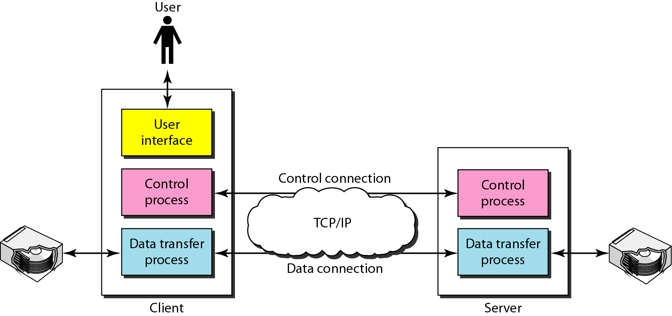
File Transfer Protocol
Control Connection: 21-Port
Data Connection: 20-Port

Slide 7
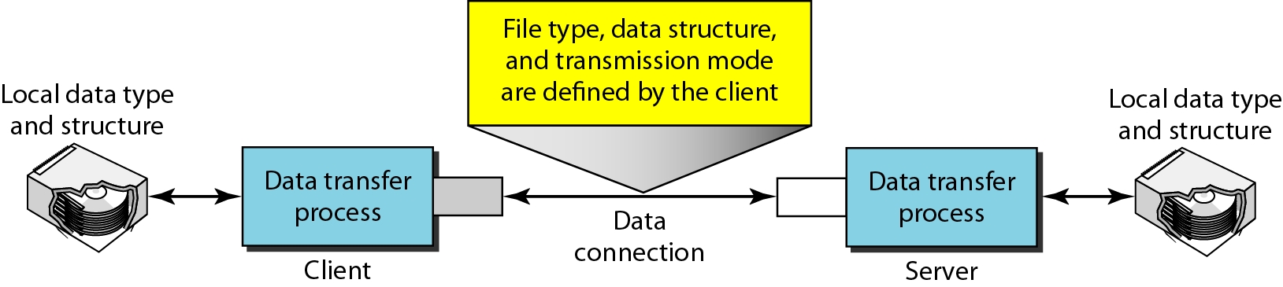
File Transfer Protocol

Slide 8
Features
FTP operates in a client/server environment, meaning that the remote machine is configured as a server, and consequently waits for the other machine(client) to request a service from it.
In UNIX, the service is provided by what is called a daemon, a small task that runs in the background. The FTP daemon is called ftpd.
The FTP protocol is used for transferring one file at a time, in either direction, between the client machine (the one which initiated the connection, i.e. the calling machine) and the server machine (which provided the FTP service, i.e. the called machine).
The FTP protocol can also perform other actions, such as creating and deleting directories (only if they are empty), listing files, deleting and renaming files, etc.

Slide 9
Types of connections
When an FTP client connects to an FTP server it opens a connection to the FTP control port 21. Then the client tells the FTP server whether to establish an active or passive connection.
The type of connection chosen by the client determines how the server responds and on what ports transactions will occur.

Slide 10
Types of connections
Active Connections:
When an active connection is established, the server opens a data connection to the client from port 20 to a high range port on the client machine.
All data from the server is then passed over this connection.

Slide 11
Types of connections
Passive Connections :When a passive connection is established, the client asks the FTP server to establish a passive connection port, which can be on any port higher than 10,000.
The server then binds to this high-numbered port for this particular session and relays that port number back to the client. The client then opens the newly bound port for the data connection.
Each data request the client makes results in a separate data connection. Most modern FTP clients attempt to establish a passive connection when requesting data from servers.

Slide 12
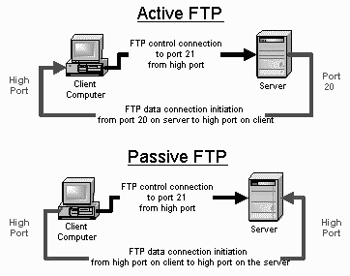
Types of connections

Slide 13
World Wide Web (WWW)
The WWW today is a distributed client/server service, in which a client using a browser can access a service using a server. However, the service provided is distributed over many locations called sites.

Slide 14

Architecture of WWW

Slide 15
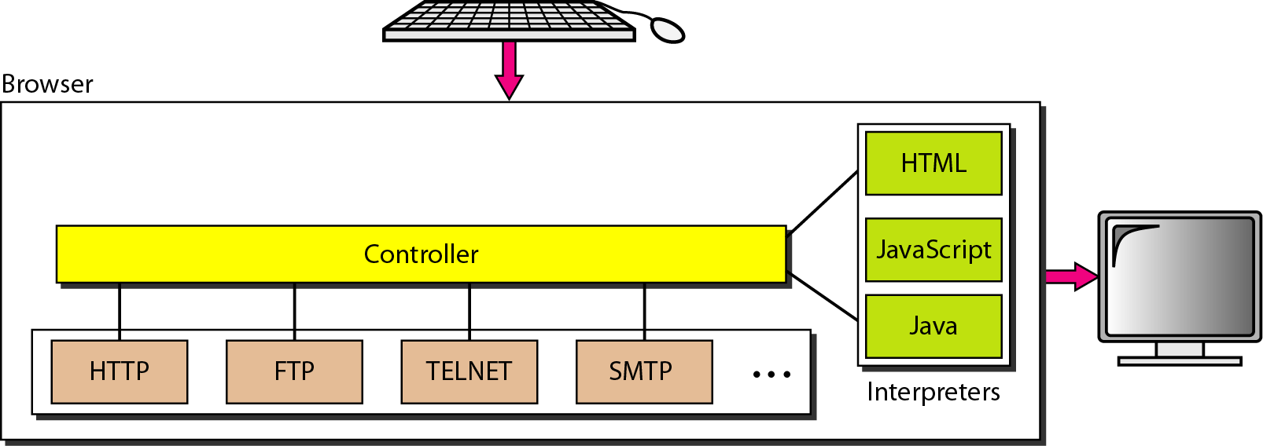
Browser

Slide 16
Uniform Resource Locator (URL)

Slide 17
WEB DOCUMENTS
The documents in the WWW can be grouped into three broad categories: static, dynamic, and active. The category is based on the time at which the contents of the document are determined.

Slide 18
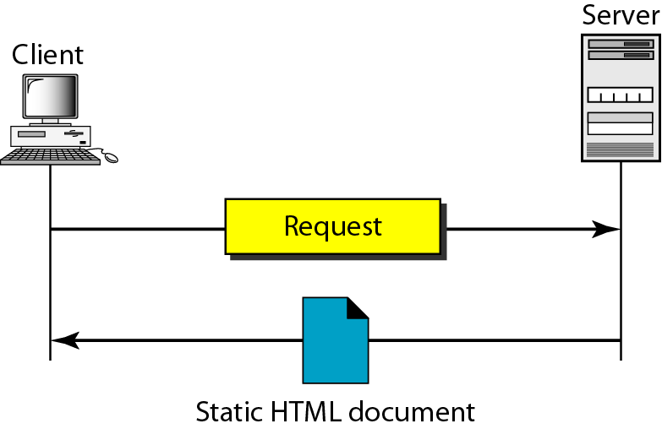
Static document

Slide 19
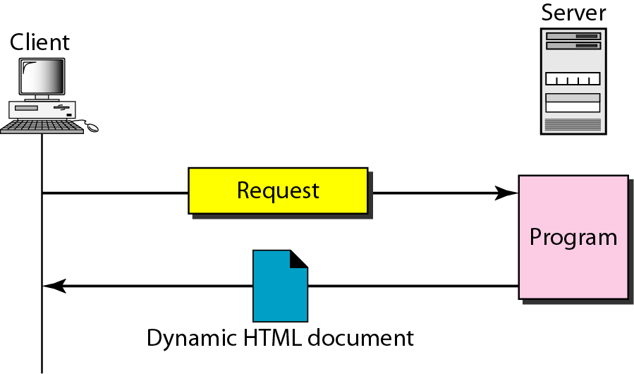
Dynamic document using CGI

Slide 20
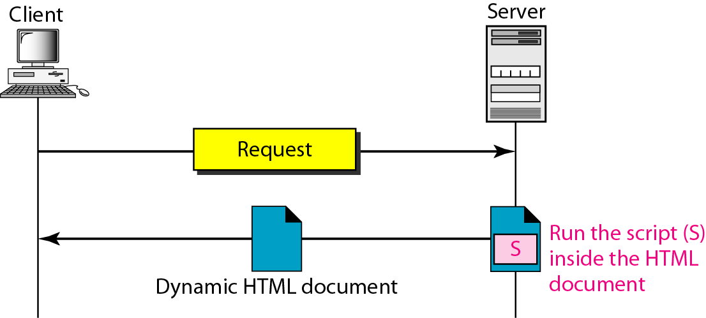
Dynamic document using server-site script

Slide 21

Note
Dynamic documents are sometimes referred to as server-site dynamic documents.

Slide 22
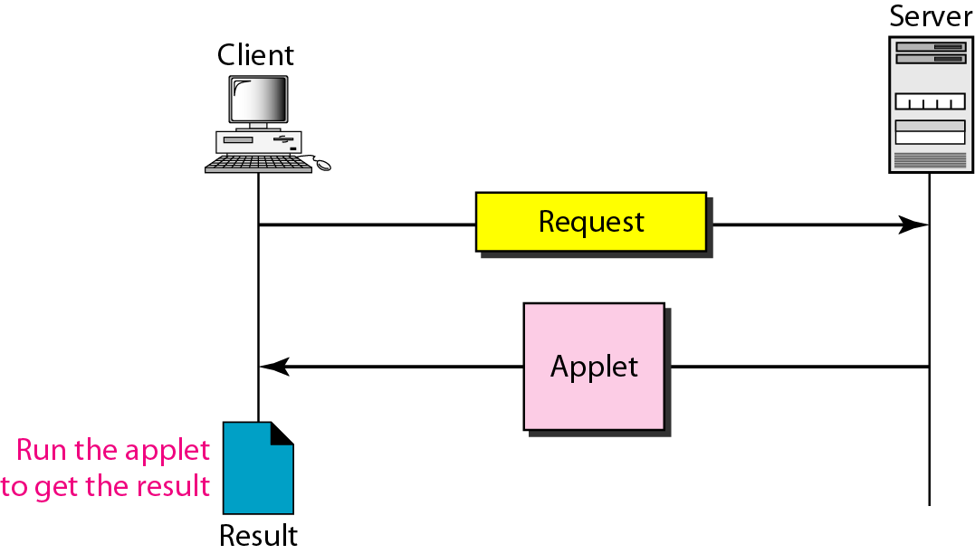
Active document using Java applet

Slide 23
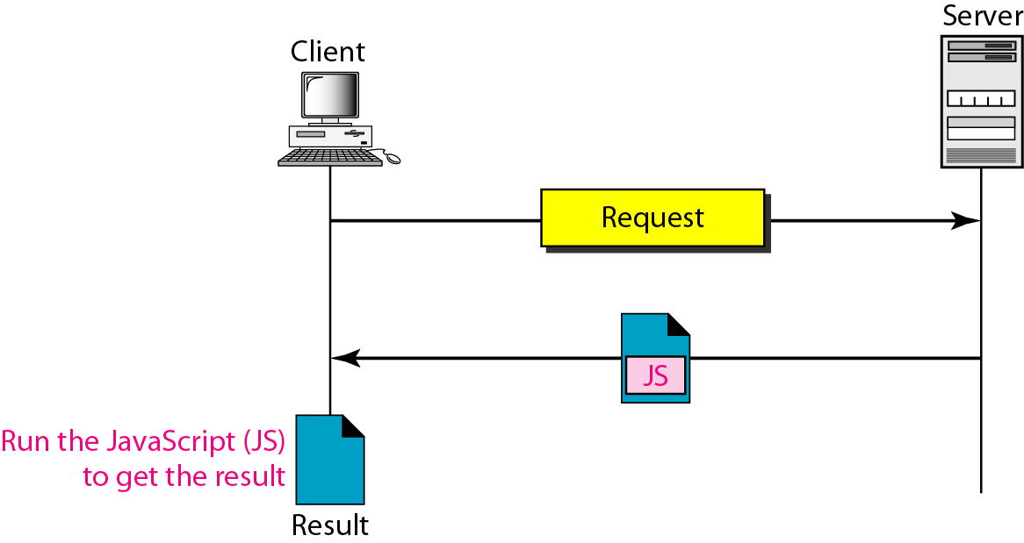
Active document using client-site script

Slide 24
Note
Active documents are sometimes referred to as client-site dynamic documents.

Slide 25
Hypertext Transfer Protocol (HTTP)
The Hypertext Transfer Protocol (HTTP) is a protocol used mainly to access data on the World Wide Web. HTTP functions as a combination of FTP and SMTP.

Slide 26
Note
HTTP uses the services of TCP on well-known port 80.

Slide 27
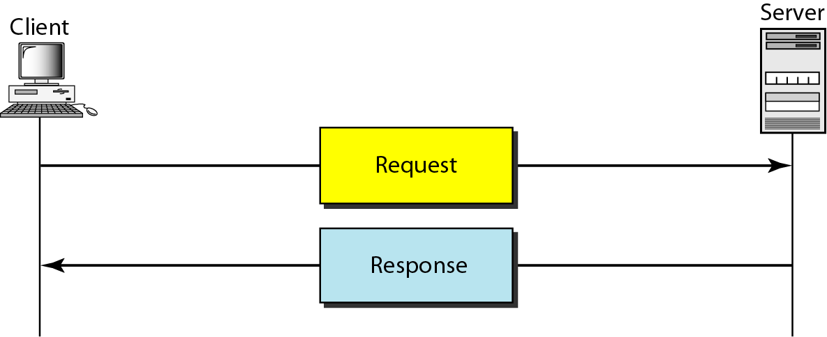
HTTP transaction

Slide 28
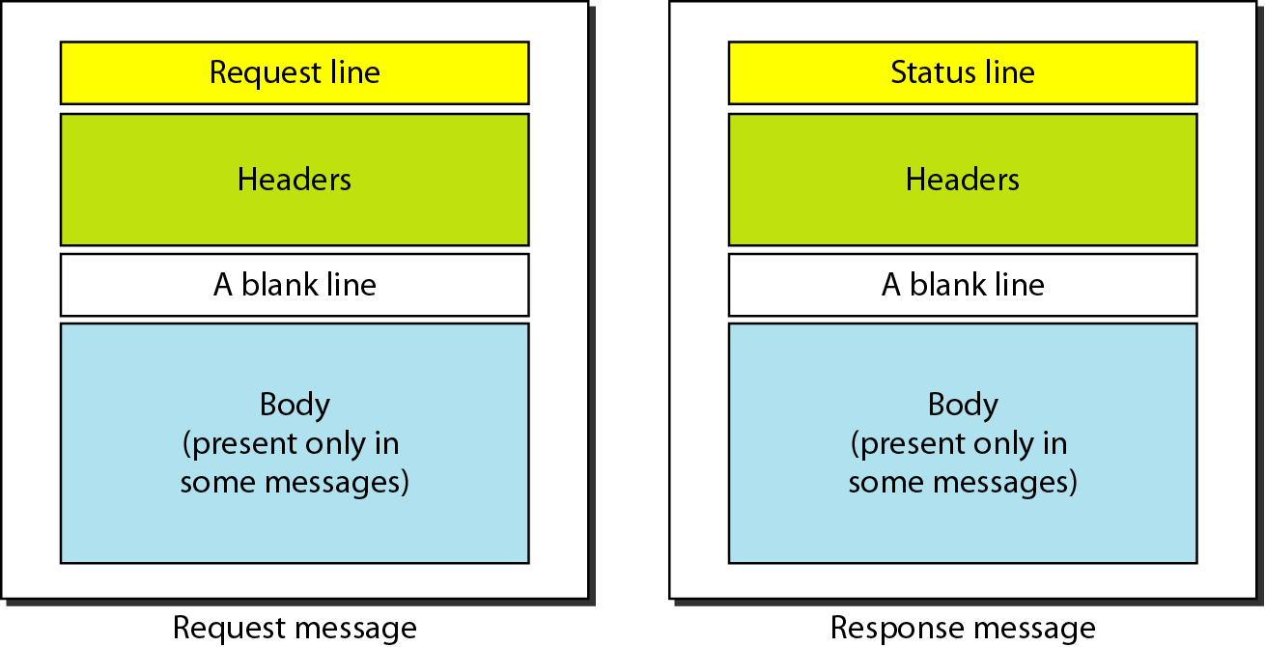
Request and response messages

Slide 29
Simple Mail Transfer Protocol (SMTP)

Slide 30
ELECTRONIC MAIL
One of the most popular Internet services is electronic mail (e-mail). The designers of the Internet probably never imagined the popularity of this application program. Simple Mail Transfer Protocol (SMTP) is an Internet standard for e-mail transmission.

Slide 31
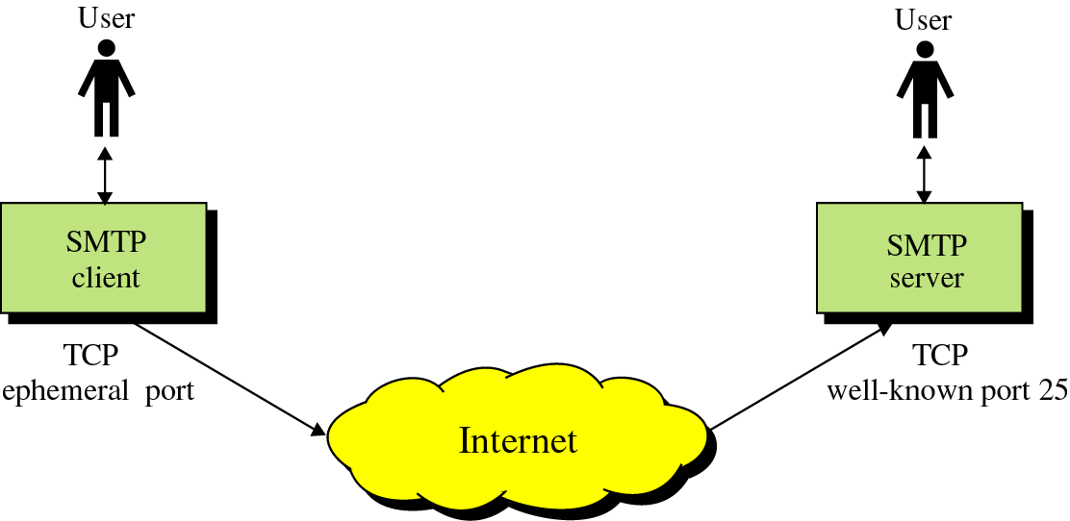
SMTP

Slide 32
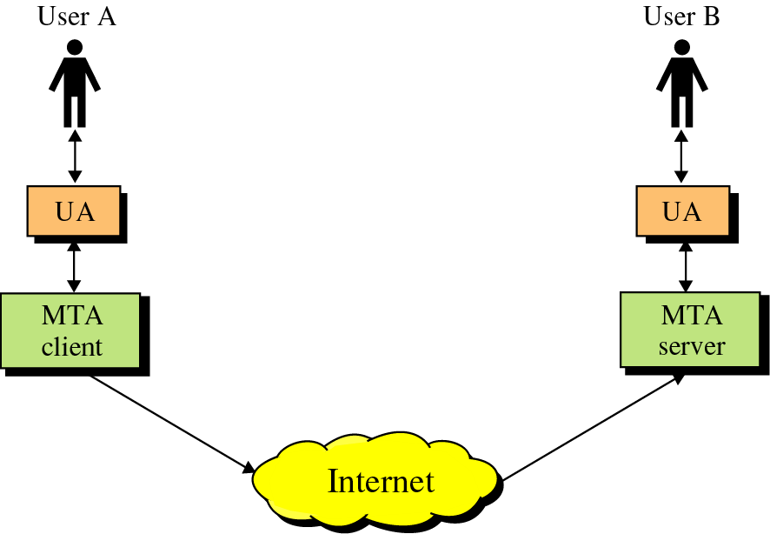
SMTP
SMTP clients and servers have two main components
  User Agents – Prepares the message, encloses it in an envelope. (ex. Outlook, Eudora)
  Mail Transfer Agent – Transfers the mail across the internet (ex. Sendmail, Exim)
User Agents
Mail Transfer Agents

Slide 33

Figure First scenario in electronic mail

Slide 34
Note
When the sender and the receiver of an e-mail are on the same system,
we need only two user agents.

Slide 35

Figure Second scenario in electronic mail

Slide 36
Note
When the sender and the receiver of an e-mail are on different systems, we
need two UAs and a pair of
MTAs (client and server).

Slide 37

Figure Third scenario in electronic mail

Slide 38
Note
When the sender is connected to the mail server via a LAN or a WAN,
we need two UAs and two pairs
of MTAs (client and server).

Slide 39

Figure Fourth scenario in electronic mail

Slide 40

Figure Push versus pull in electronic email

Slide 41
Note
When both sender and receiver are connected to the mail server via
a LAN or a WAN, we need two
UAs, two pairs of MTAs
and a pair of MAAs.
This is the most common situation today.

Slide 42

Figure Services of user agent

Slide 43
Note
Some examples of command-driven user agents are mail, pine,
and elm.

Slide 44
Note
Some examples of GUI-based user agents are Eudora, Outlook, and Netscape.

Slide 45

Figure Format of an e-mail

Slide 46

Figure E-mail address

Slide 47
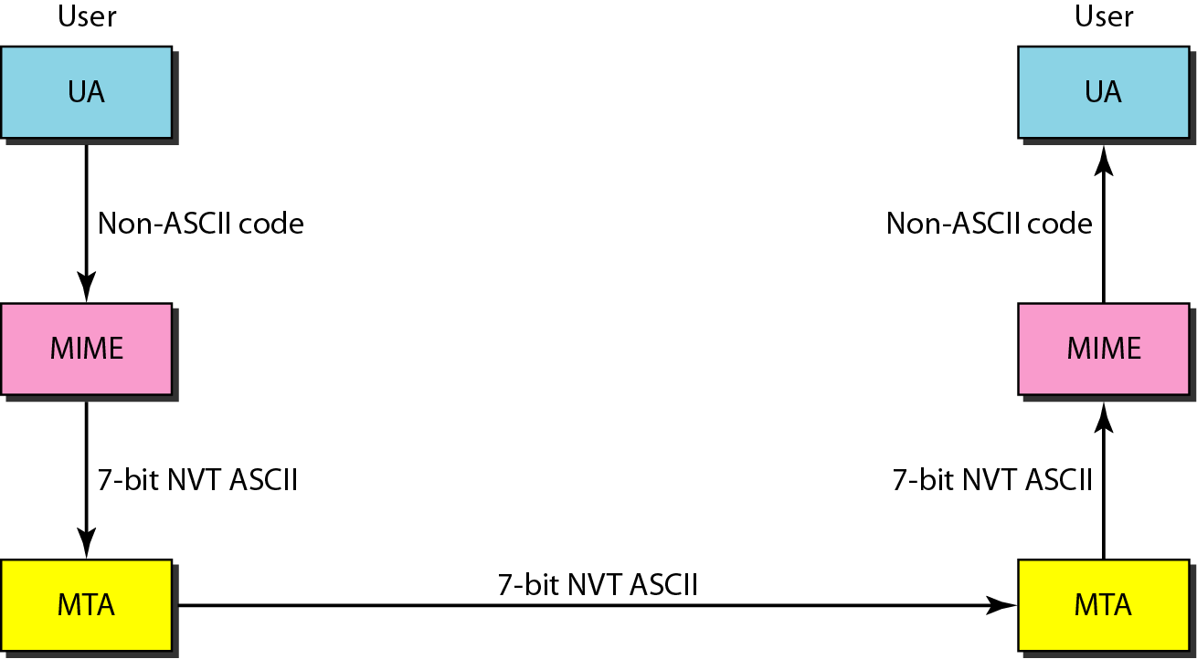
Figure Multi-purpose Internet Extension (MIME)

Slide 48
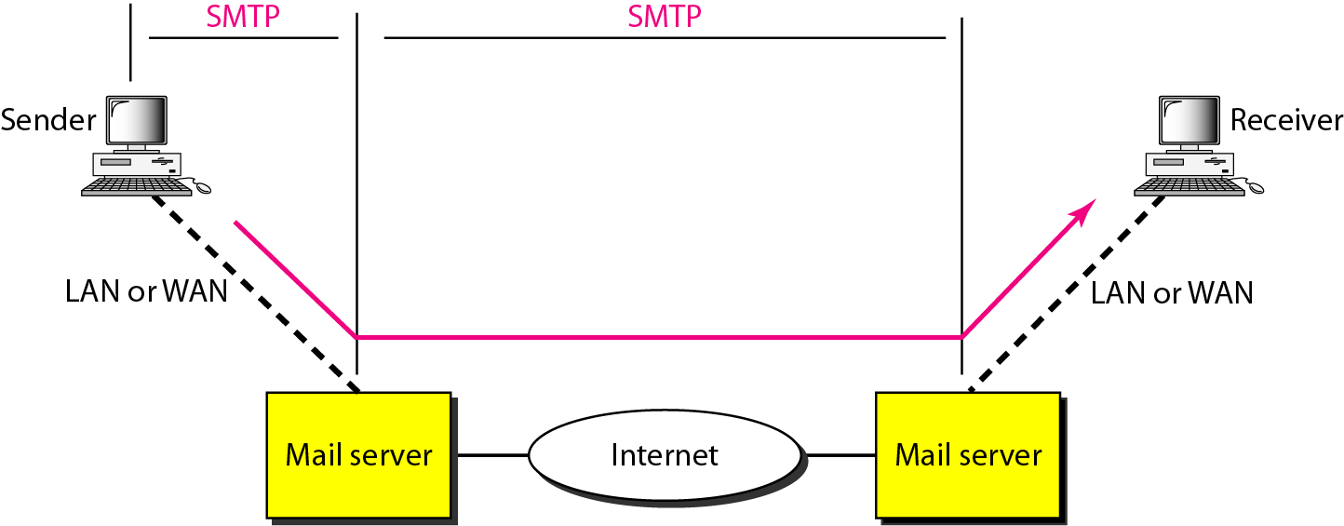
Figure SMTP range

Slide 49

Figure Commands and responses

Slide 50
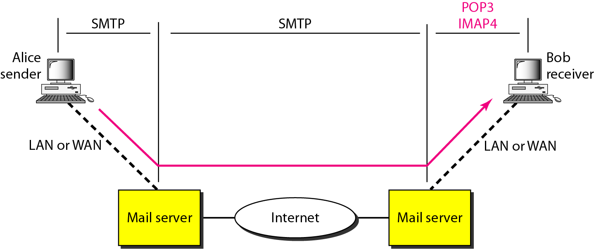
Figure POP3 and IMAP4

Slide 51
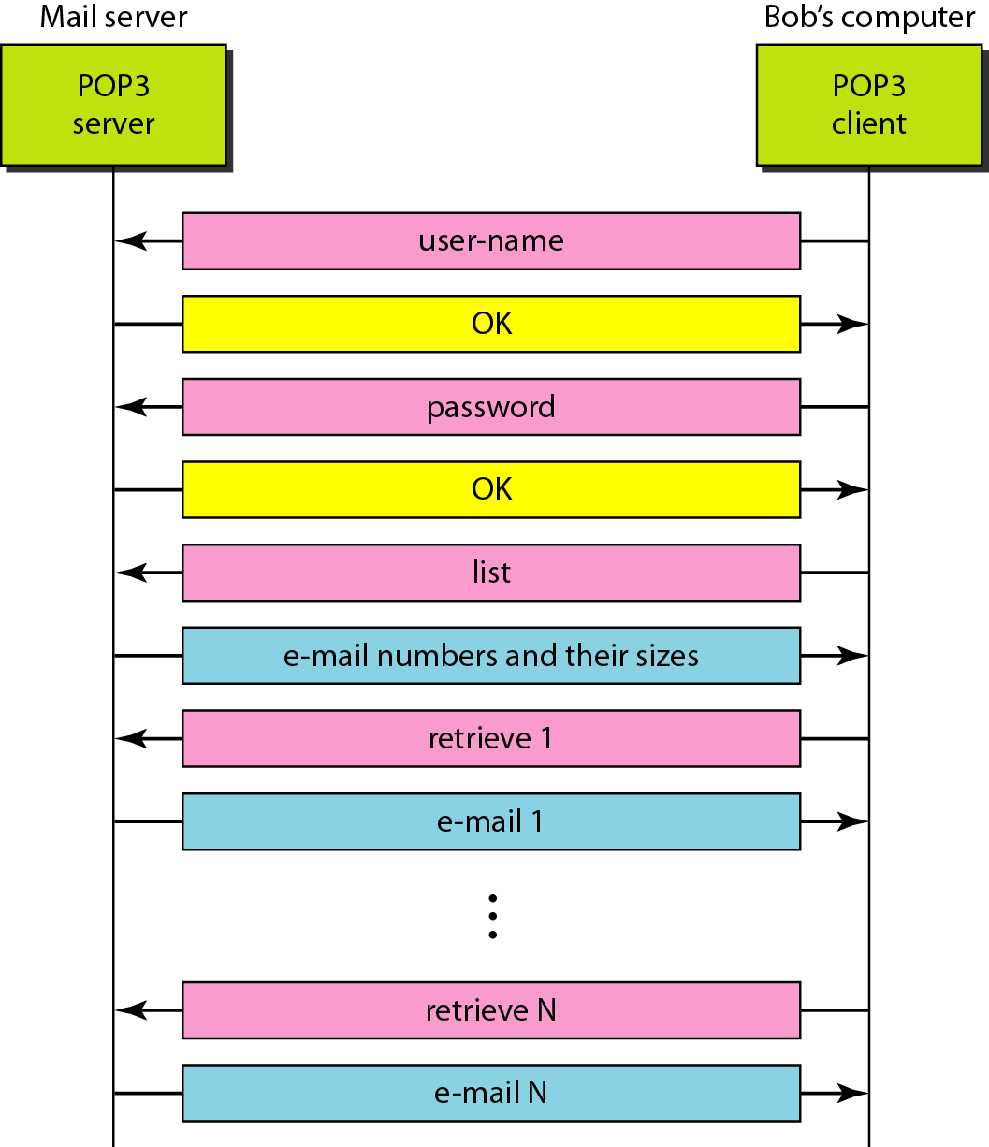
Figure The exchange of commands and responses in POP3

Slide 52
Post Office Protocol v3
Simple
Allows the user to obtain a list of their Emails
Users can retrieve their emails
Users can either delete or keep the email on their system
Minimizes server resources

Slide 53
Internet Mail Access Protocol v4
Has more features than POP3
User can check the email header before downloading
Emails can be accessed from any location
Can search the email for a specific string of characters before downloading
User can download parts of an email
User can create, delete, or rename mailboxes on a server

Slide 54
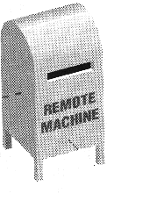
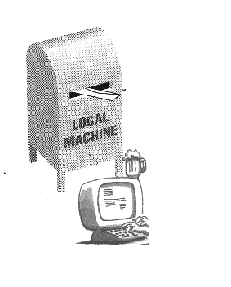

POP vs. IMAP
POP3:
All Messages
Internet
Whole message
IMAP:
Dr.Amer
Friends
….
headers
Internet

Slide 55
Thank You

